Slide 1
Chemistry A Level
6th Form Induction day

Slide 2
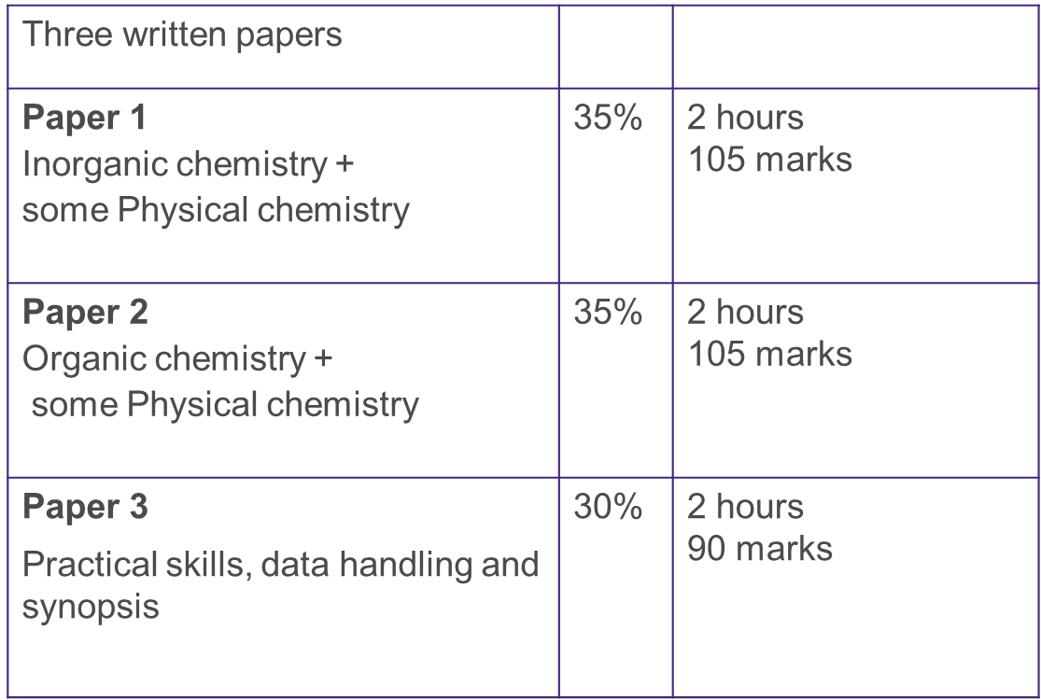
AQA Chemistry A Level

Slide 3
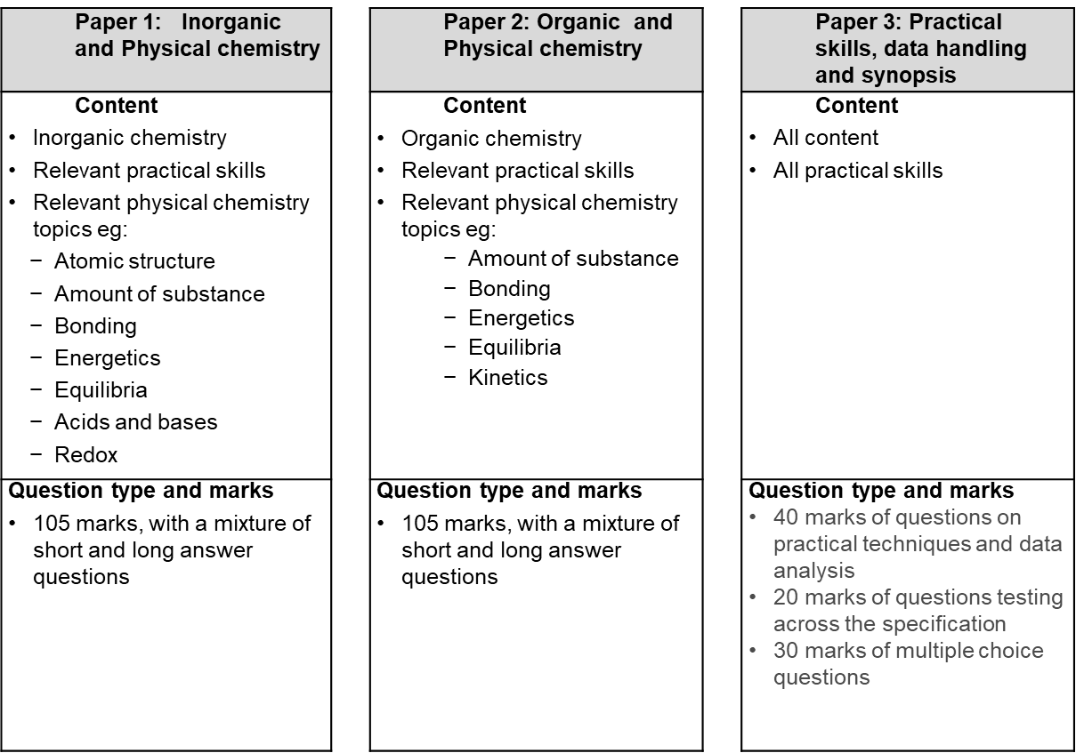
AQA Chemistry Content

Slide 5
Competencies
Follows written instructions
Applies investigative approaches and methods when using instruments and equipment
Safely uses a range of practical equipment and materials
Makes and records observations
Researches, references and reports

Slide 6
Why study chemistry?
If you wanted to go into a career in any form of medicine including doctor or veterinarian then you will find A-level chemistry compulsory, however there are many subjects and careers where this is the case, as well as there being many options where an A-level chemistry qualification is desirable. Having an A-level in chemistry is a very desirable trait and is a highly respected qualification to have in academic circles.
Possible career and course options available to you and your A-level chemistry qualification include:
Medicine
pharmacy
veterinary science
chemistry
biochemistry
food science/nutrition
forensic science
biological/engineering careers
optical management
Optometry
Microbiology
natural sciences
Pharmacology
software engineering
and physiology, and these all require A-level chemistry as essential (unless other qualifications are offered).
Careers and courses that find chemistry desirable include food technology, nursing, physiotherapy, radiography, paramedical courses, law and zoology.

Slide 7
How is chemistry delivered?
4 lessons a week – I will try to include as many practicals as possible, not just the required practicals
Every other week I will meet with students for a one to one meeting where I deal with any issues in lessons and also help organise revision resources and independent study
You will have a year 13 mentor who you will meet with every week to go over topics and check understanding of topics.
I expect from you –
Notes to be kept in a folder with assessments
Independent work including practice exam questions, practice math skill questions and practical write ups.
Prior reading of each topic

Slide 8
Required practical 5
Testing a product from distillation
Test on the distillate to confirm the formation of ethanal
Tollens’ silver mirror test:
a) Prepare a sample of Tollens’ reagent by adding 5 drops of sodium hydroxide solution to 2 cm3 of silver nitrate solution in a test tube.
b) To this test tube add just enough dilute ammonia solution to dissolve the brown precipitate completely.
c) Using a beaker of hot water (50–60 °C), gently warm approximately 5 cm3 of this test reagent in a test tube.
d) Add 10 drops of the distillate containing ethanal to the warmed Tollens’ reagent in the test tube. Wait a few minutes and note what happens. You should have produced a silver mirror on the walls of the tube.

